Slide 1
Tourist Information System
BY
G.REVATHI M.com.,B.ED.,HDCA., PGDca., Data Analyst

Slide 2
Aim of the Project
Comprehensive Destination Details : The Tourist Information System will provide users with detailed information on popular tourist destinations in India, including major attractions, local activities, and cultural highlights.
Transportation Information : Users will receive essential information on transportation options to and within the destination, including details on flights, trains, buses, and local transit systems.

Slide 3
Business Problem or Problem Statement
Tourists need detailed info to plan trips well.
No one-stop platform for reliable info causes inconvenience.
Travel experience suffers without easy access to info.
Solution needed: create a system that gathers and presents tourist info in one place.

Slide 4
Project Description
Create a Python command-line app.
Store and retrieve tourist info for Indian destinations.
Use a set dataset with details on attractions, activities, and transportation.
Users input a destination name to access relevant info.
Aims to improve travel planning process.

Slide 5
Functionality
Add Destination : Allows the addition of a new destination with its associated information.
Retrieve Information: Fetches and displays information about a specific destination entered by the user.
List Destinations : Lists all available destinations to inform users about their options.
User Interaction : Provides an interactive command-line interface for user input and output.

Slide 6
Input Versatility with Error Handling and Exception Handling :
Input Handling :
The system prompts the user to enter the name of a destination.
Error Handling :
If the user inputs a destination that is not in the system, the system responds with "Destination not found."
Exception Handling :
The system gracefully handles keyboard interrupts (Ctrl+C) and end-of-file errors (Ctrl+D) to exit the program without crashing.

Slide 7
Results and Outcomes
Comprehensive Platform: The Tourist Information System provides a centralized platform for accessing detailed information about popular destinations in India, covering attractions, activities, and transportation options.
Improved Accessibility: Travelers benefit from improved access to tourist information, facilitating effective trip planning. This accessibility enhances the overall travel experience and helps users make informed decisions.

Slide 8
Results and Outcomes
Enhanced User Experience: The system offers a user-friendly interface, ensuring a seamless experience for accessing destination information. This aspect contributes to user satisfaction and encourages continued engagement with the platform.
Increased Tourism Promotion: By showcasing diverse attractions and activities, the system contributes to raising awareness and promoting tourism in India. It serves as a valuable tool for highlighting the country's rich cultural heritage and scenic beauty to both domestic and international travelers.

Slide 9
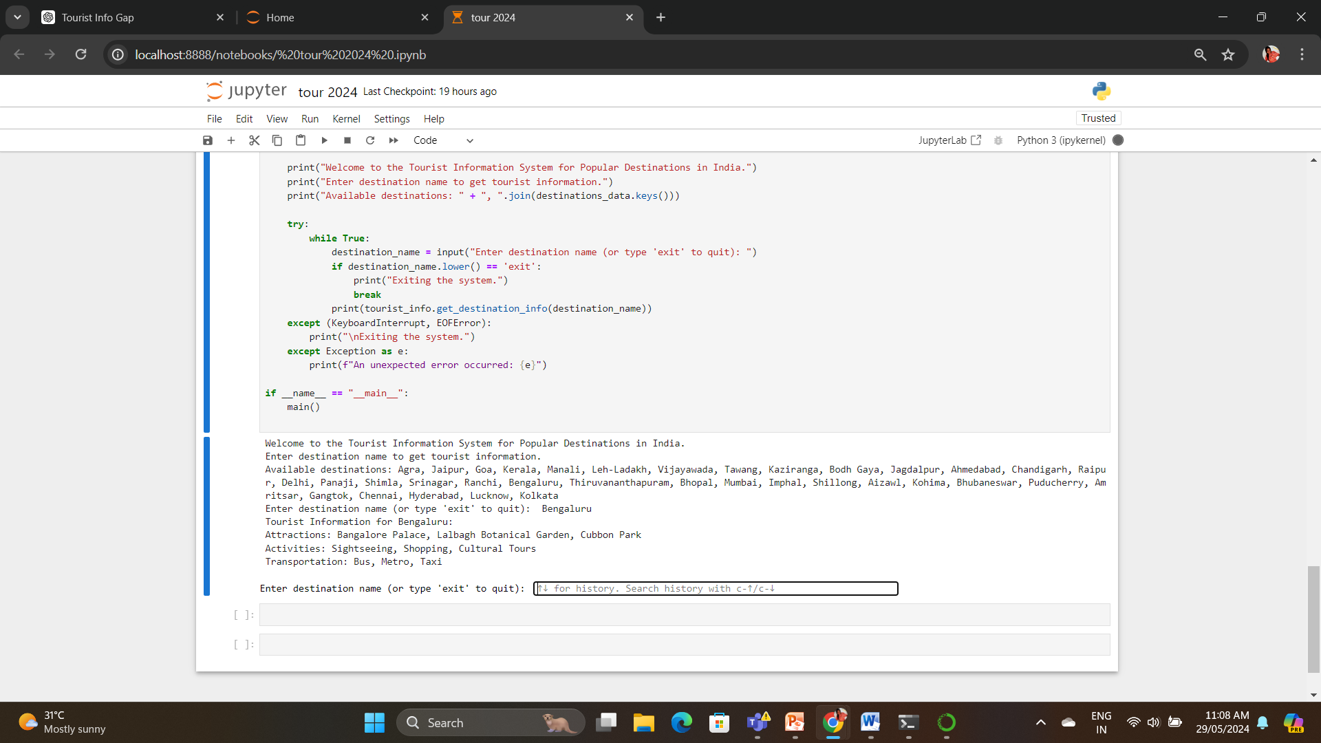

Slide 10
Conclusion
The Tourist Information System provides a valuable tool for tourists planning their trips to various destinations in India. By consolidating and presenting essential information in a user-friendly manner, the system enhances the travel planning process, helping users make informed decisions. The project successfully addresses the need

Slide 11
thank you

